Slide 1
Advanced Es6 & TypeScript
Israel
Z.

Slide 2
Table of content
Equality
References
Null and Undefined
‘this’ key word and Closure
‘var’, ‘let’ and ‘const’ key words
Rest Parameters
Spread operator
Destructuring
‘for’, ‘of’, ‘in’ key words and iterators
Template strings
Enums and union types
‘promise’ and async await key words
Casting and type assertion
‘typeof’ and ‘instanceof’ key words
Generators
Symbols

Slide 3

Equality
One thing to be careful about in JavaScript is
the difference between == and ===.

Slide 4
Equality
Equals Operator ( == )
The comparison x == y with equals operator, where x and y are values, produces true or false. The important thing to know is that while comparing both values, JavaScript runtime will perform type conversions to make both values of same type.
Strict Equals Operator ( === )
The comparison x === y with equals operator, where x and y are values, produces true or false only when –
types of x and y are same.
values of x and y are equal.

Slide 5
Equality
Similar to == vs. ===, there is != vs. !==.
Always use === and !==.
TypeScript object equality is the same as JavaScript object equality.

Slide 6
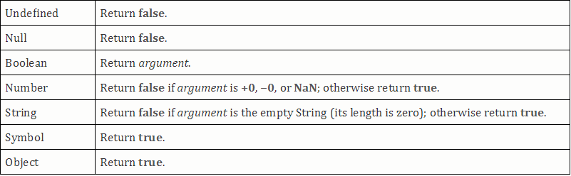
Equality
Conditional statements such as the ‘if’
statement evaluate their expression using
coercion with the ’ToBoolean’ abstract method
and always follows the same rolls.
From ES6 specification : “The abstract
operation ‘ToBoolean’ converts argument to a
value of type Boolean according to table 10”.

Slide 7
Equality
As mentioned at the table above, objects
evaluated to true.
That is why even an empty array evaluates to
true.
If([]) {
// true
// an array (even an empty one) is an object, objects will evaluate to true
}

Slide 8
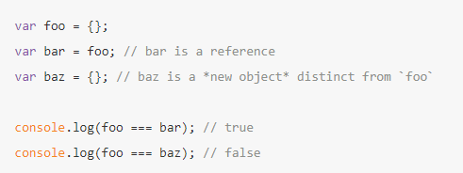
Equality of References
Any object in JavaScript (including functions,
arrays, regexp etc) are references.
Object equality is for references:

Slide 9
Null and undefined
TypeScript has two special types, null and undefined, that have the values null and undefined, respectively.
By default, null and undefined are valid values of every type. However, as of TypeScript 2 if a variable/parameter/return type of a function could be a string or null you will have to type it as such with a union type of both: string | null. Same for undefined.
This behavior can be change using ‘strictNullChecks’ flag in tsconfig.json file.

Slide 10
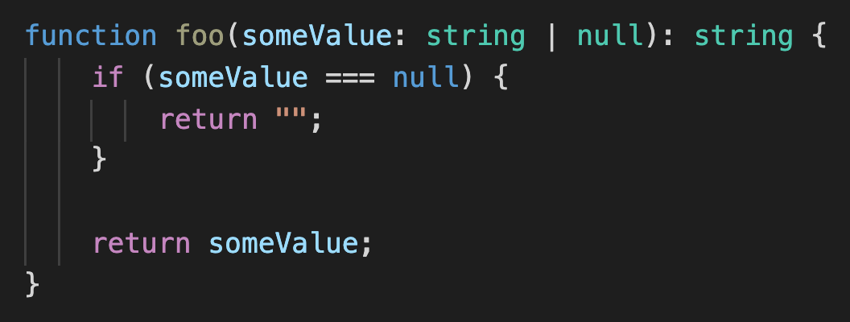
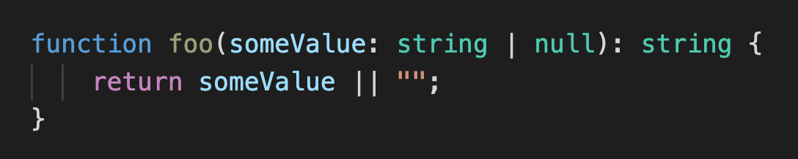
Null and undefined
Let's see some examples:

Slide 11
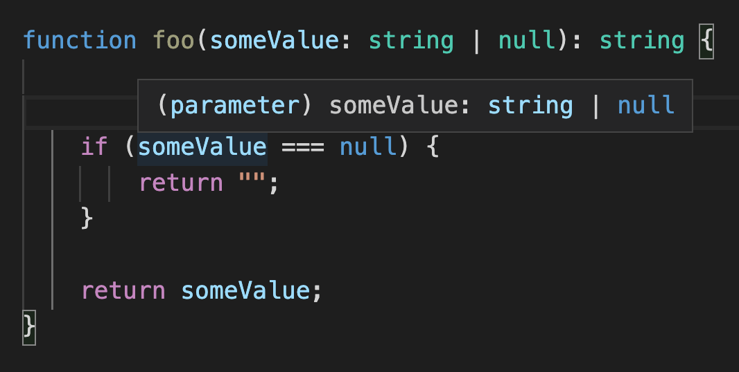
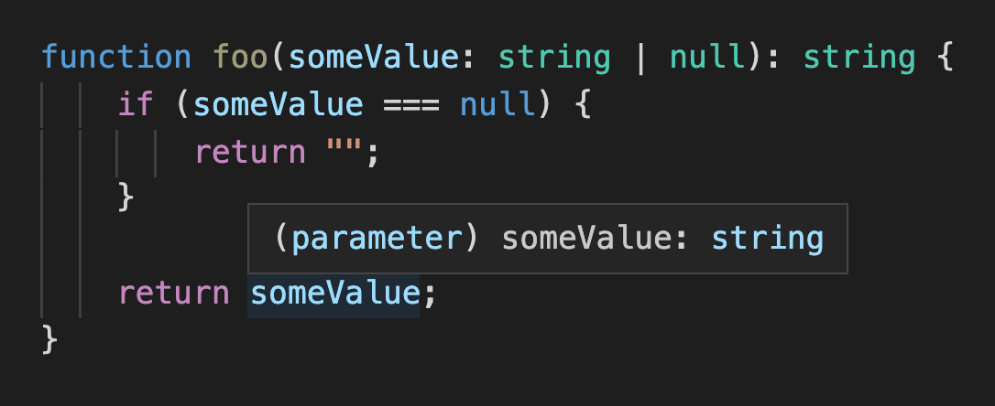
Null and undefined
What do we see here?

Slide 12
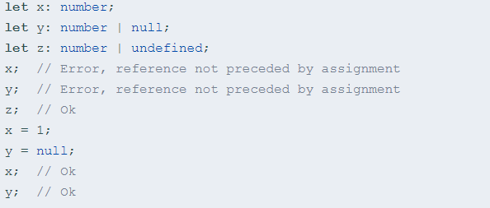
Null and undefined
In strict null check mode, the compiler requires every
reference to a local variable of a type that doesn’t include
undefined to be initialized before its usage.

Slide 13

Null and undefined
Optional parameters and properties automatically
have undefined added to their types, even when
their type annotations don’t specifically
include undefined.
For example, the following two types
are identical:

Slide 14
Null and undefined
A null value represents a reference that points, generally intentionally, to a nonexistent or invalid object or address.
In APIs, null is often retrieved in a place where an object can be expected but no object is relevant.
Something hasn't been initialized : undefined.
Something is currently unavailable: null.

Slide 15
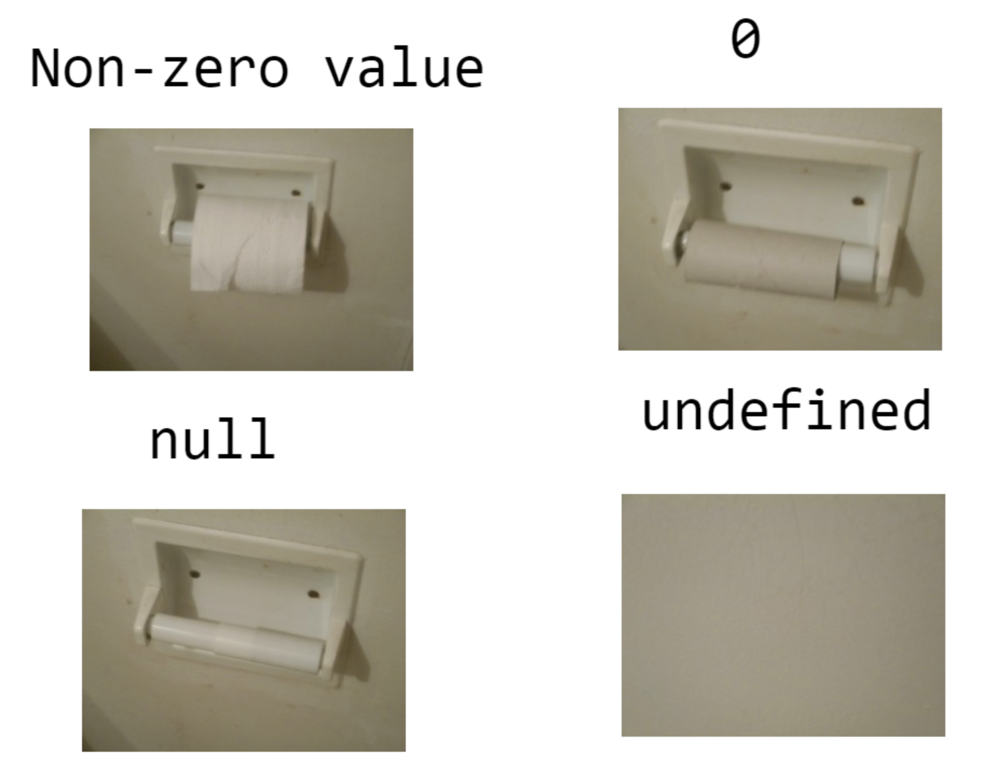
Null and undefined

Slide 16
Null and undefined
both when negated are giving true (falsy values), but none of them equals true or false.
In JavaScript, undefined has its own data type (undefined), null is only an object.
In JavaScript, null is treated as 0 in basic arithmetic operations, undefined returns ‘NaN’.

Slide 17

Null and undefined
Let's see some practical difference:
What is the output of:
logHi(null);
logHi(undefined);

Slide 18
Null and undefined
logHi('bye'); // bye
logHi(undefined); // hi
logHi(null); // null

Slide 19
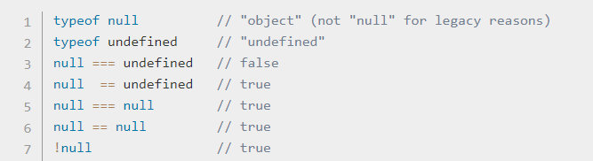
Null and undefined
How JavaScript sees null and undefined ?
Why null == undefined equals to true ?

Slide 20
‘This’ key word and Closure
The this keyword in JavaScript (and thus TypeScript) behaves differently than it does in many other languages.

Slide 21
‘This’ key word and Closure
What is this in JavaScript?
When a function is invoked in JavaScript, you can
follow these steps to determine what this will be
(these rules are in priority order):
If the function was the result of a call to function.bind, this will be the argument given to bind.
If the function was invoked in the form foo.func(), this will be foo.
In a global context, If in strict mode, this will be undefined.
Otherwise, this will be the global object (window in a browser).

Slide 22
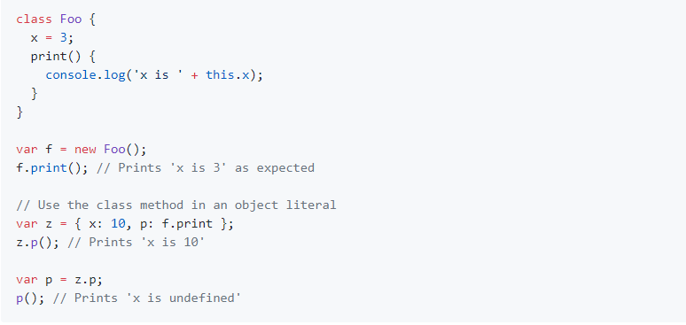
‘This’ key word and Closure
What is this in JavaScript?

Slide 23
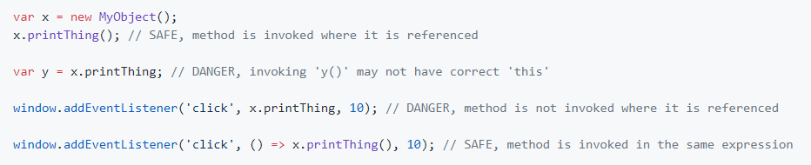
‘This’ key word and Closure
Red Flags for this:
The biggest red flag you can keep in mind is the
use of a class method without immediately
invoking it.
Any time you see a class method being referenced
without being invoked as part of that same
expression, this might be incorrect.

Slide 24
‘This’ key word and Closure
TypeScript uses _this in its transpile process,
so never use _this as a variable or property name.

Slide 25
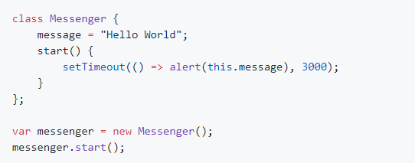
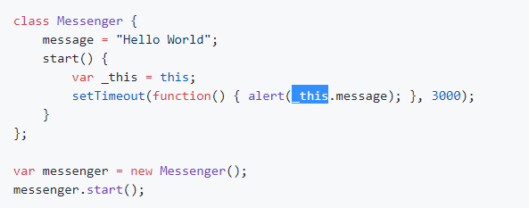
‘This’ key word and Closure
For example:
Transpiles to:

Slide 26
‘This’ key word and Closure
The TypeScript compiler applies this type of transformation
to rewrite arrow function expressions into standard function
expressions.

Slide 27
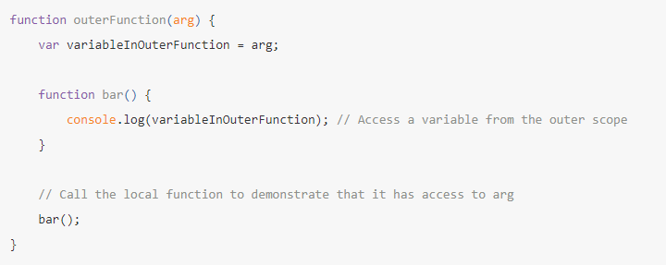
‘This’ key word and Closure
Closure
A function in JavaScript has access to any variables defined
in the outer scope.

Slide 28
‘This’ key word and Closure
Closure
You can see that the inner function has access to a variable
(variableInOuterFunction) from the outer scope.
The variables in the outer function have been closed by (or
bound in) the inner function.
Hence the term closure.
The concept in itself is simple enough and pretty intuitive.

Slide 29
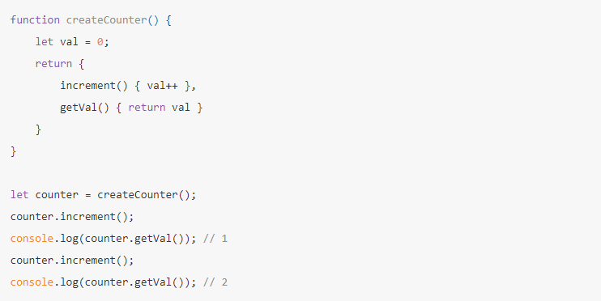
‘This’ key word and Closure
Closure
How to achieve private members in JavaScript?

Slide 30
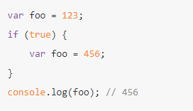
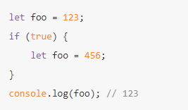
‘var’, ‘let’ and ‘const’
var variables in JavaScript are function scoped.
‘{‘ does not create a new variable scope.
TypeScript (and ES6) introduces the let and const keywords to allow you to define variables with true block scope.

Slide 31
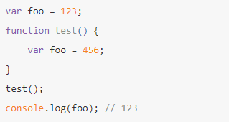
‘var’, ‘let’ and ‘const’
Functions create a new scope.

Slide 32
‘var’, ‘let’ and ‘const’
var foo = '123';
if (true) {
let foo = 123;
}
// becomes
var foo = '123';
if (true) {
var foo_1 = 123;
}

Slide 33
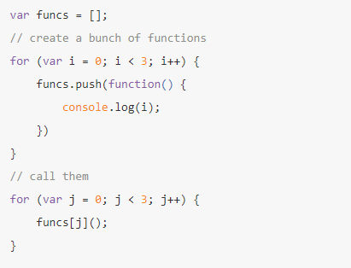
‘var’, ‘let’ and ‘const’
What is the output?

Slide 34
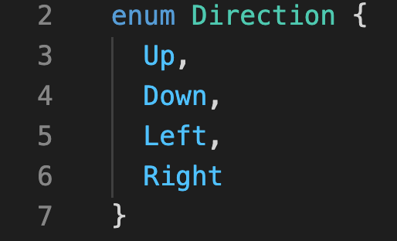
Enums
Enums allow a developer to define a set of named constants.
Numeric enums are auto incremented from the last initialized value.
The default first value is 0.
We will always prefer to initialize the first value with a number the is different from 0.

Slide 35
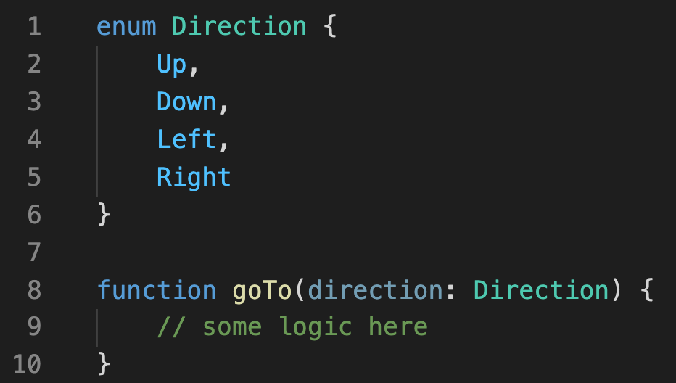
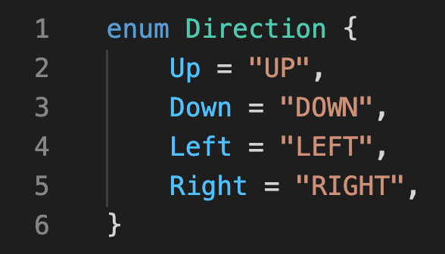
Enums
Usage example.
Enums can also have string values.

Slide 36
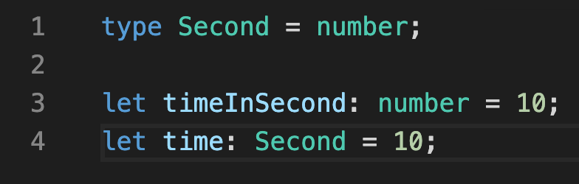
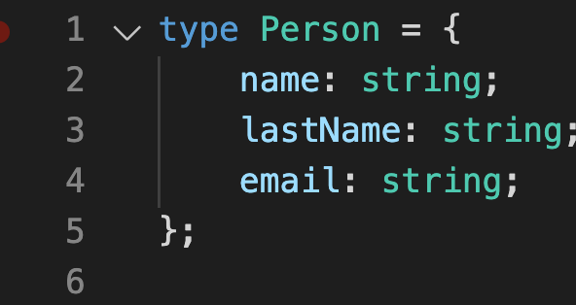
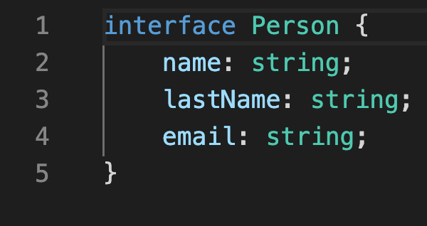
union types & type alias
TypeScript provides convenient syntax for providing names for type annotations that you would like to use in more than one place
Type aliases create a new name for a type.
Type alias can be used like an interface.

Slide 37
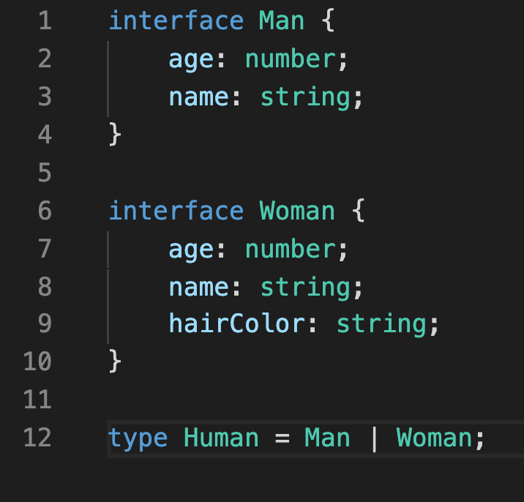
union types & type alias
Unlike an interface you can give a type alias to literally any type annotation.
If you need to have hierarchies of Type annotations use an interface. They can be used with implements and extends.

Slide 38
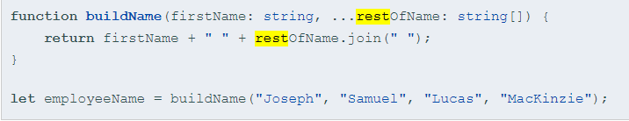
Rest Parameters
Rest parameters allow you to quickly accept multiple arguments in your function and get them as an array.
The rest syntax is simply three dots …
Rest parameters are treated as a boundless number of optional parameters.
When passing arguments for a rest parameter, you can use as many as you want. You can even pass none.
The compiler will build an array of the arguments passed in with the name given after the ellipsis (...), allowing you to use it in your function.
Rest parameter must be the last argument (compile time error).

Slide 39

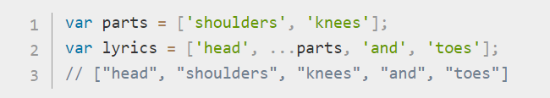
Spread operator
The main objective of the spread operator is to spread the elements of an array or object.
The syntax is similar to rest parameters, simply three dots …

Slide 40
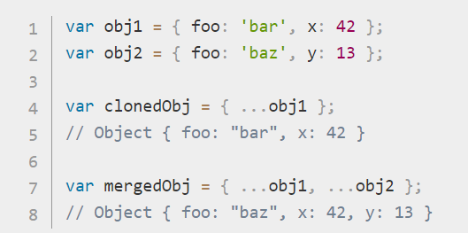
Spread operator
Spread syntax effectively goes one level deep while copying an array. Therefore, it may be unsuitable for copying objects array.
When using spread operator on objects it copies own enumerable properties from a provided object onto a new object.

Slide 41

Spread operator
Spread syntax (other than in the case of spread properties) can be applied only to iterable objects:
In a way, rest syntax is the opposite of spread syntax: spread 'expands' an array into its elements, while rest collects multiple elements and 'condenses' them into a single element.

Slide 42
Spread operator
Some useful examples:
arr1.push(…arr2) // adds arr2 to the end of arr1
arr1.unshift(…arr2) // adds arr2 to the start of arr1
var arr1 = […arr2] // copy elements of arr2 to arr1
var arr1 = […arr2, …arr3, …arr4] // combining multiple arrays
var options = { ...defaultOptions, ...requestOptions };
// merge between two objects
var shallowCopy = { ...someObj };

Slide 43
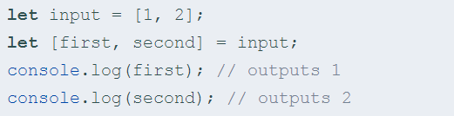

Destructuring
TypeScript supports the following forms of Destructuring (literally named after de-structuring i.e. breaking up the structure.
Array destructuring
This creates two new variables first and second, this is equivalent to:

Slide 44
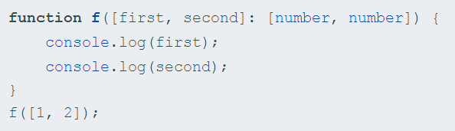
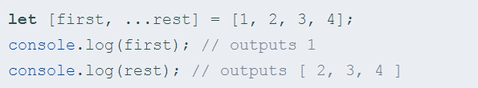
Destructuring
Destructuring works with already-declared variables as well.
Also work in function parameters
You can create a variable for the remaining items in a list:

Slide 45
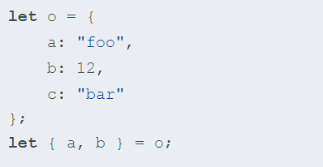
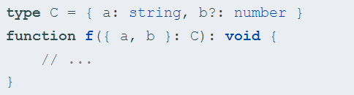
Destructuring
Object destructuring:

Slide 46
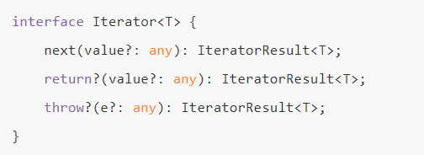
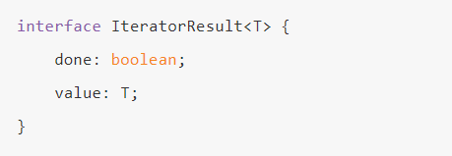
‘for’, ‘of’, ‘in’ and iterators
ES6 introduced Iterator, which is an object that exposes three methods, next, return, and throw.
The desired class should implement Iterable<T> (see the next example).

Slide 47


Template strings
Syntactically these are strings that use backticks ( i.e. ` ) instead of single (') or double (") quotes.
The motivation of Template Strings are:
String Interpolation
A common use case is when you want to generate some string out of some static strings + some variables.
For this you would need some templating logic and this is where template strings get their name from.
Until today you would write something like:
From now on:

Slide 48
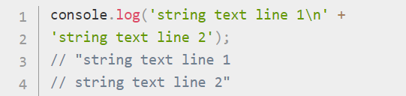
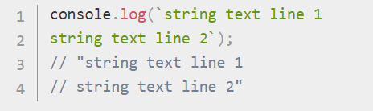
Template strings
Multiline Strings
Any newline characters inserted in the source are part of the template literal. Using normal strings, you would have to use ‘\n’ in order to get multi-line strings
From now on:

Slide 49
Promise
The Promise object represents the eventual completion (or failure) of an asynchronous operation and its resulting value.
A Promise is a proxy for a value not necessarily known when the promise is created.

Slide 50
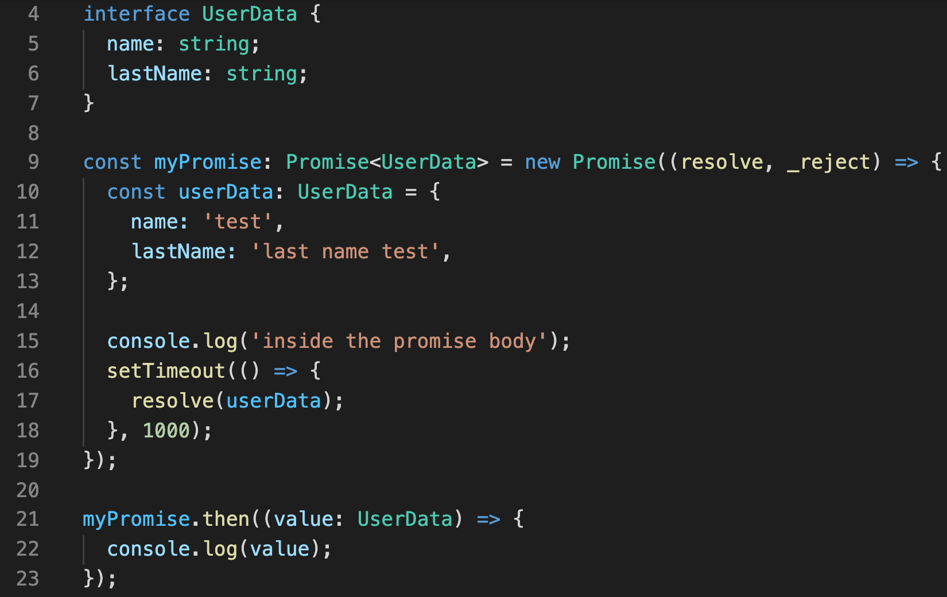
Promise
What is the output?

Slide 51
Promise
Output result -
1. "inside the promise body"
2. { "name": "test", "lastName": "last name test" }

Slide 52
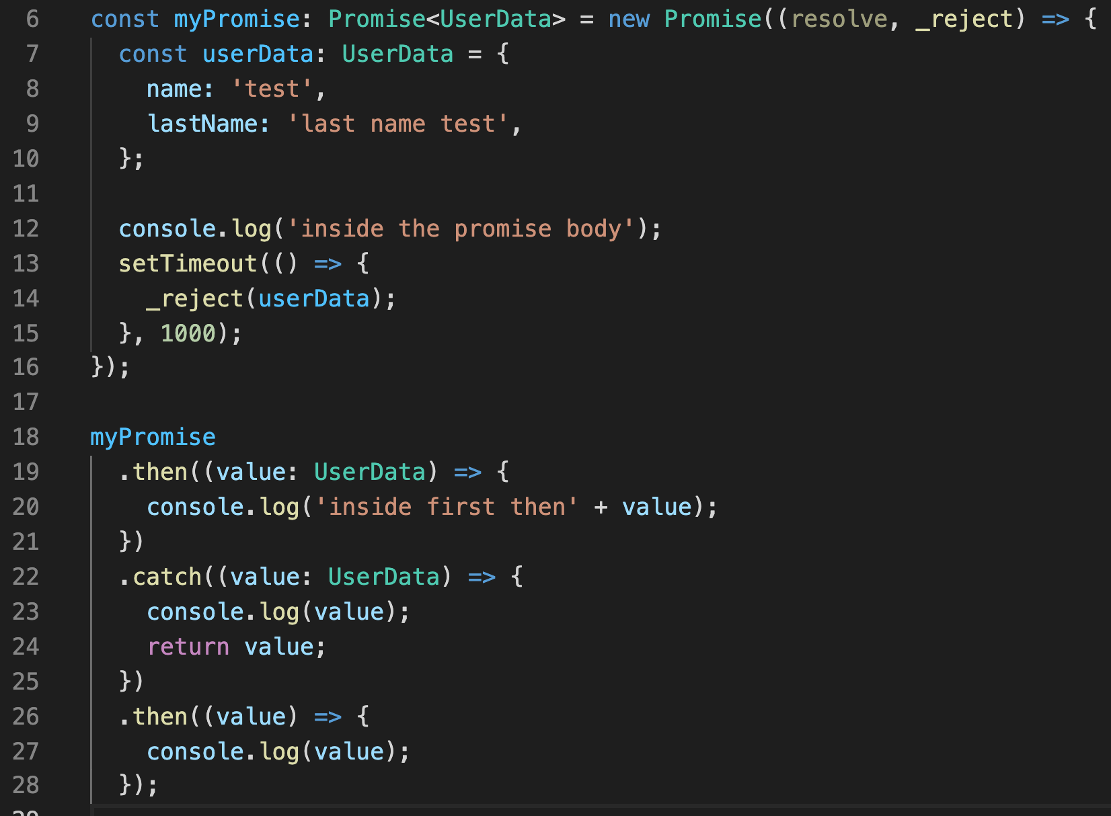
Promise
What is the output ?

Slide 53
Promise
Output result –
1. "inside the promise body"
2. { "name": "test", "lastName": "last name test" }
3. { "name": "test", "lastName": "last name test" }

Slide 54
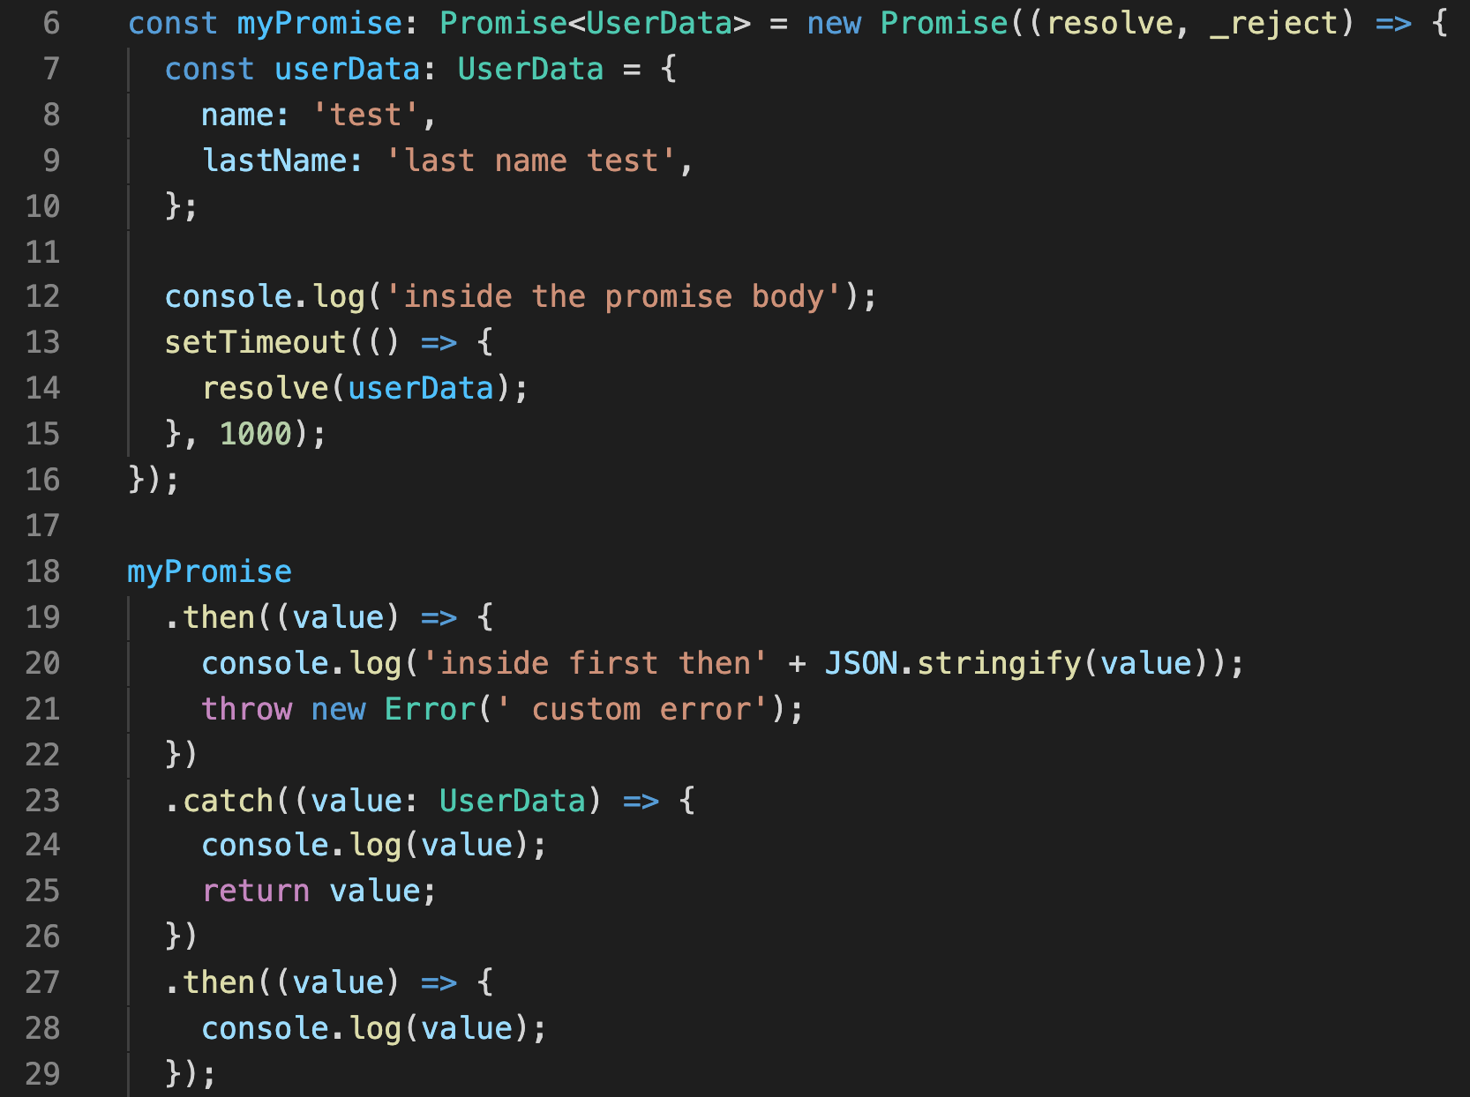
Promise
What is the output ?

Slide 55
Promise
Output result –
1. "inside the promise body”
2. "inside first then{"name":"test","lastName":"last name test"}"
3. custom error
4. custom error

Slide 56
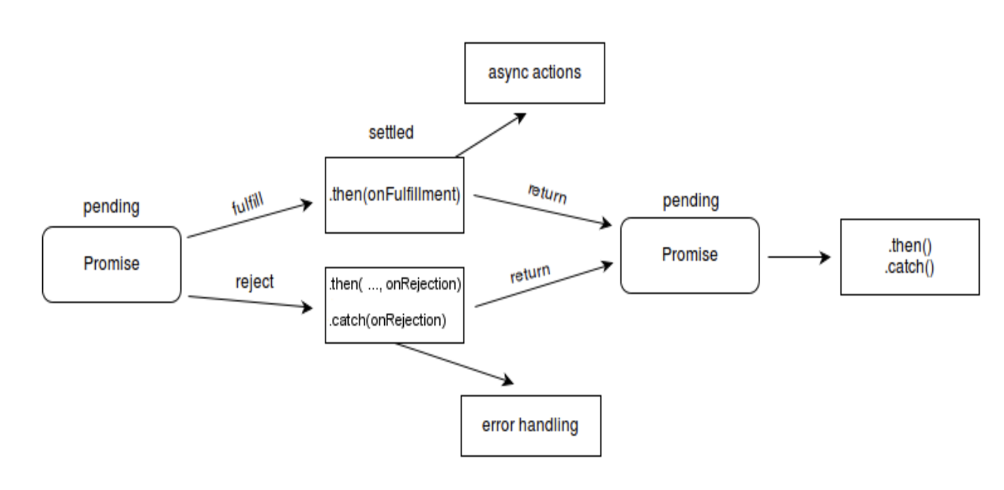
Promise

Slide 57
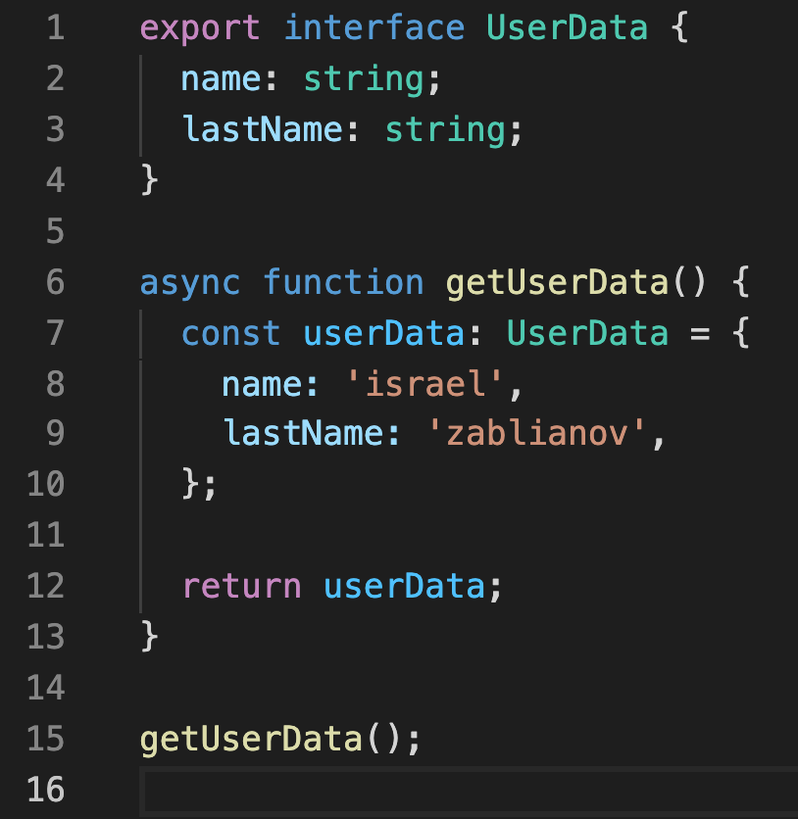
Async Await – key words
Before we explain, lets have an example.
What is the return type of the function getUserData ?

Slide 58
Async Await – key words
An async function is a function that knows how to expect the possibility of the await keyword being used to invoke asynchronous code.
async function always returns a promise.
If you return a value from async function that is not a promise, it will automatically wrap the value with a promise.
Errors thrown inside async function can be handled using the catch method on promise or via try...catch... block.

Slide 59
Async Await – key words
An async function is a function that knows how to expect the possibility of the await keyword being used to invoke asynchronous code.
async function always returns a promise.
If you return a value from async function that is not a promise, it will automatically wrap the value with a promise.
Errors thrown inside async function can be handled using the catch method on promise or via try...catch... block.

Slide 60
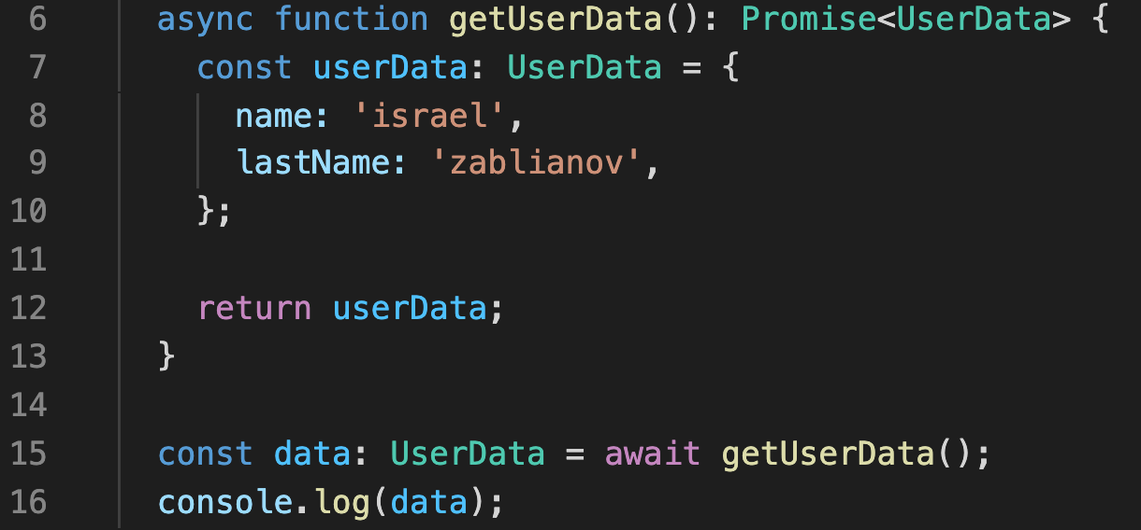
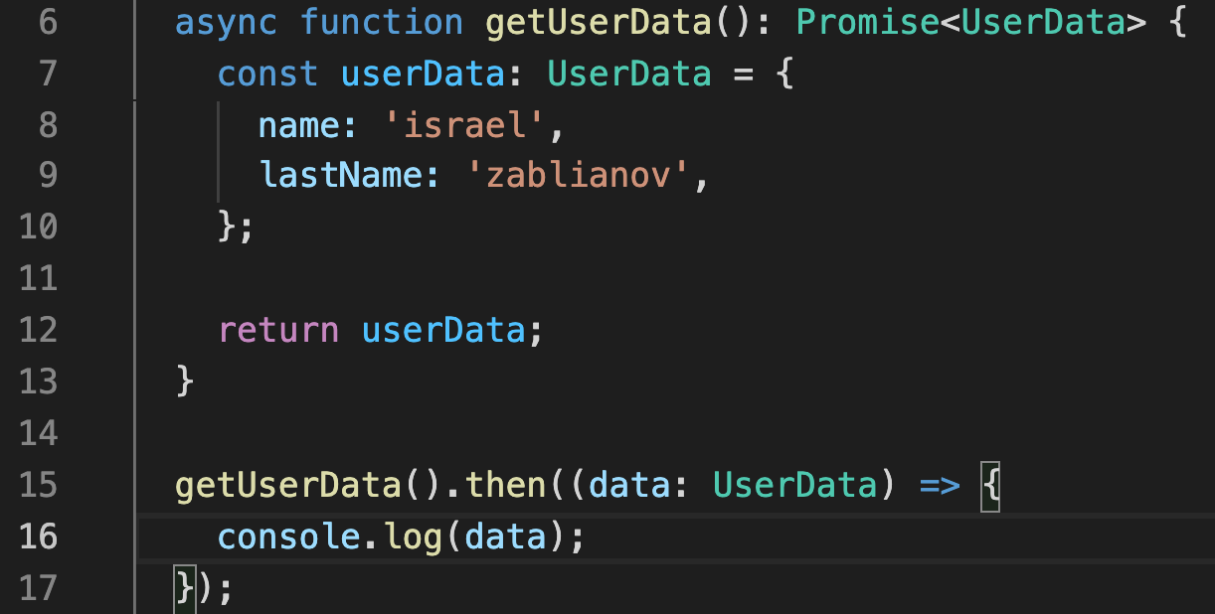
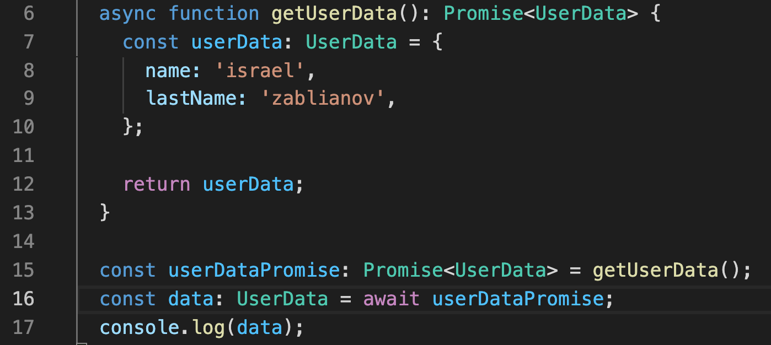
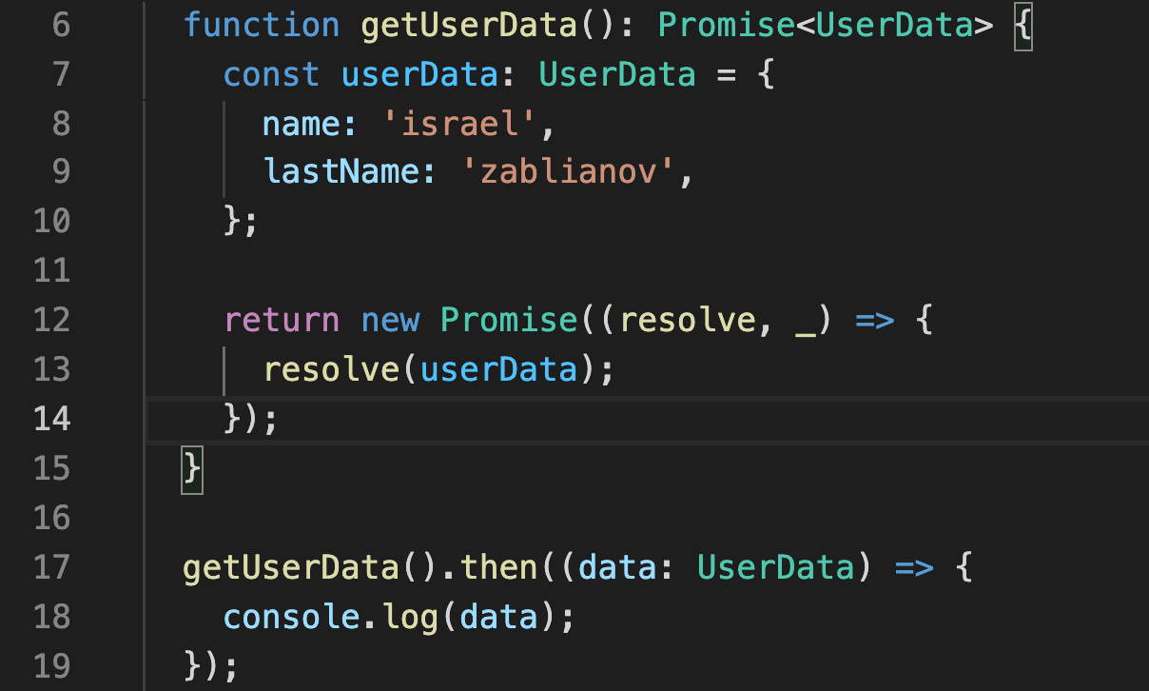
Async Await – key words

Slide 61
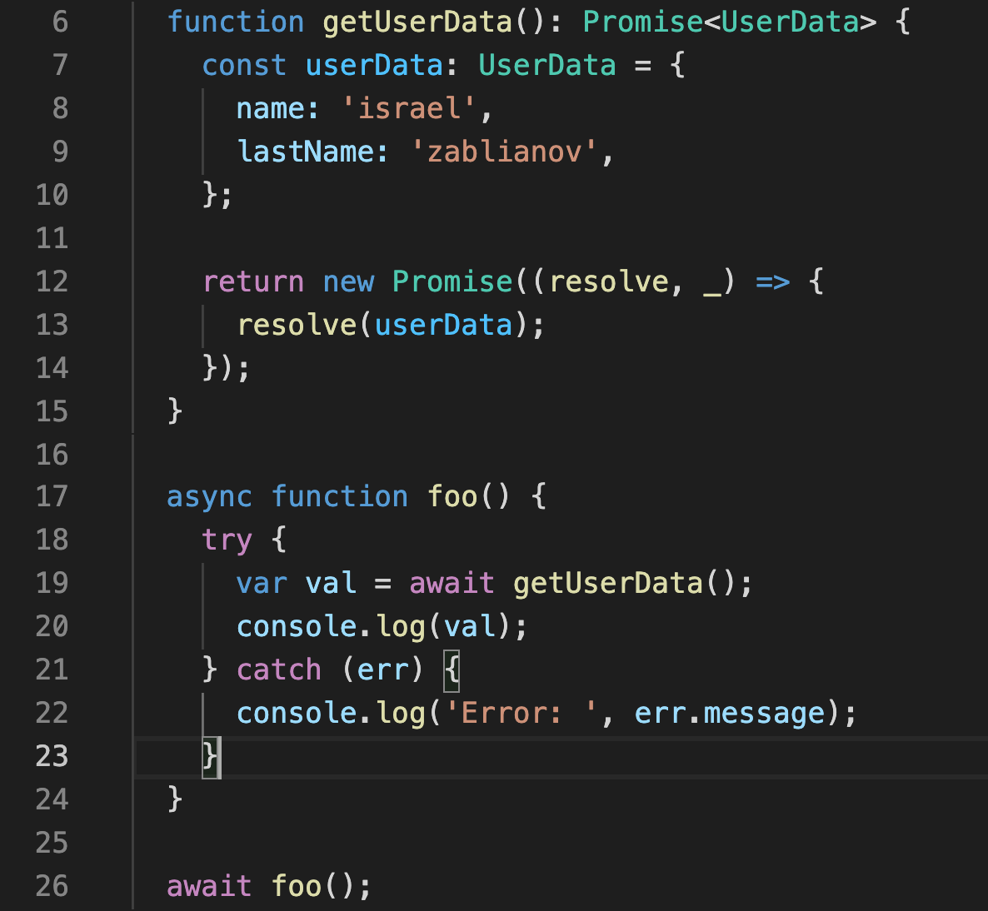
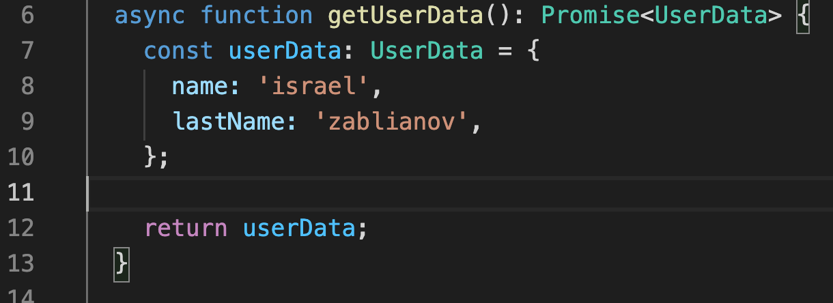
Async Await – key words
Alternative implementation for getUserData function

Slide 62
Extra
The next slides are a bit more advance.
I encourage you to read them and ask about them, but they are not part of our course.

Slide 63
Template strings
Tagged Templates
You can place a function (called a tag) before the template string and it gets the opportunity to pre process the template string literals plus the values of all the placeholder expressions and return a result.
Tags allow you to parse template literals with a function.
The first argument of a tag function contains an array of string values.
The remaining arguments are related to the expressions.
In the end, your function can return your manipulated string or it can return something completely different.

Slide 64
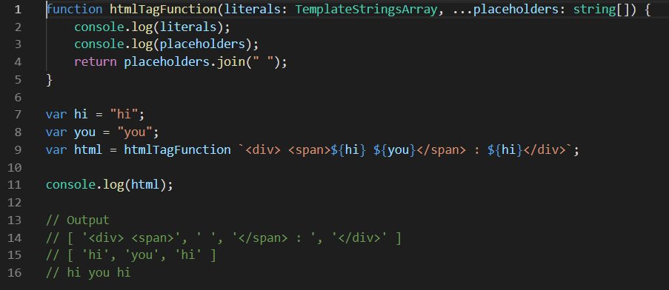
Template strings
Check out some real life uses here

Slide 65

‘for’, ‘of’, ‘in’ and iterators

Slide 66
‘for’, ‘of’, ‘in’ and iterators
The name of the method that returns all the data of the iterable object is ‘Symbol.iterator’. This is ES6 standart.
Symbols offer names that are unique and cannot clash with other property names.
Symbol.iterator will return an object called an iterator.

Slide 67


‘for’, ‘of’, ‘in’ and iterators
for… of.. Iterate over Iterable object e.g., arrays and other objects that implementing iterator design pattern.
for… in… iterate over object keys

Slide 68

Generators
function * is the syntax used to create a generator function.
Calling a generator function returns a generator object.
The generator object follows the iterator interface (i.e. the next, return and throw functions).
Generator functions can be used to create lazy iterators.

Slide 69

Generators
Generators essentially allows a function to pause its execution and pass control (fate) of the remainder of the function execution to the caller.

Slide 70
Generators
// Output
Starting iteration
Execution started { value: 0, done: false }
Execution resumed { value: 1, done: false }
Execution resumed { value: undefined, done: true }
The function only starts execution once next is called on the generator object.
The function pauses as soon as a yield statement is encountered.
The function resumes when next is called.

Slide 71

Generators
you can control the resulting value of the yield expression using iterator.next(valueToInject).
yield allows a generator function to pause its communication and pass control to an external system.

Slide 72
Generators
There will be times when we want to combine the values of one or more generators into a single one.
Or, we want to factor out generator logic into a separate function so that it can be used multiple times.
With “regular” programming we would just create the factored out function and call it as needed.
However, it’s not as simple in generator land.
We don’t want to call the helper generator function to get back its return value.
If we did that, we’d just get a new generator for that helper generator function.
We actually want it to continue to yield into our current generator.
What we want to do is delegate the generator’s population to another generator function.
And we can do this using yield*

Slide 73

Generators
What it the output?

Slide 74
Generators
'before'
'Generators'
'are'
'awesome!'
'between'
1
2
3
4
5
'after'

Slide 75

Generators
binary tree example taking from the Generators chapter of Axel Rauschmayer’s Exploring ES6 book.

Slide 76

Symbols
symbol is a primitive data type, just like number and string.
The Symbol constructor accepts an optional string key, which can be used for debugging but not to access the symbol itself.

Slide 77


Symbols
Symbols are:
Immutable
Unique
Can be used as keys for object properties

Slide 78

Symbols
In addition to user-defined symbols, there are well-known built-in symbols.
E.g. Symbol.iterator
A method that returns the default iterator for an object. Called by the semantics of the for-of statement.

Slide 79

Symbols
Symbol registry
Symbol.for(key)
“The Symbol.for(key) method searches for existing symbols in a runtime-wide symbol registry with the given key and returns it if found.
Otherwise a new symbol gets created in the global symbol registry with this key.”

Slide 80

Symbols
Symbol registry
Symbol.keyFor(symbol)
“The Symbol.keyFor(sym) method retrieves a shared symbol key from the global symbol registry for the given symbol.”

Slide 81
Resources & Useful links
http://www.typescriptlang.org
https://github.com/unional/typescript-guidelines
https://basarat.gitbooks.io/typescript
https://dev.to/aman_singh/abstract-operations-the-key-to-understand-coercion-in-javascript-453i
https://tc39.es/ecma262/#sec-abstract-operations
https://jameshenry.blog/typescript-null-and-undefined-types/
https://codeburst.io/javascript-null-vs-undefined-20f955215a2
https://codeburst.io/understanding-null-undefined-and-nan-b603cb74b44c
https://developer.mozilla.org/en-US/docs/Web/JavaScript/Reference/Global_Objects/null
https://github.com/Microsoft/TypeScript
https://msdn.microsoft.com/en-us/magazine/dn890374.aspx
https://codeburst.io/how-this-keyword-work-in-javascript-6b31104b5ef9
https://bytearcher.com/articles/es6-vs-es2015-name/
https://codeburst.io/a-simple-guide-to-es6-iterators-in-javascript-with-examples-189d052c3d8e
http://www.ecma-international.org/ecma-262/6.0/#sec-iteration
https://www.ynonperek.com/2017/08/28/3-cool-uses-for/
http://www.benmvp.com/learning-es6-generators-as-iterators/
http://exploringjs.com/es6/ch_generators.html#leanpub-auto-iterating-over-trees
https://www.typescriptlang.org/docs/handbook/symbols.html
https://developer.mozilla.org/en-US/docs/Web/JavaScript/Reference/Global_Objects/Symbol

